Slide 1

INSTITUTE : UIE
DEPARTMENT : CSE
Bachelor of Engineering (Computer Science & Engineering)
PROJECT BASED LEARNING IN JAVA
(CST-358/ITT-358)
TOPIC OF PRESENTATION:
JSP declaration, JSP directives, JSP Scriptlets (CO 5)
DISCOVER . LEARN . EMPOWER

Slide 2

Lecture Objectives
In this lecture, we will discuss:
JSP declaration, JSP directives, JSP Scriptlets

Slide 3
What is JSP?
JSP stands for Java Server Pages, a technology invented by Sun to allow the easy creation of server side HTML pages.
JSP lies in the presentation tier on the web server, with the main responsibility of generating HTML content that needs to be served to the browser. It also has the additional responsibility of pass on the requests to the backend through the JavaBeans, as and when required.

Slide 4
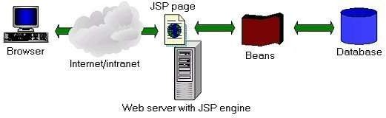
Why JSP?
High performance
Convenient to code and maintain as against servlets
Separates presentation from content
Powered by Java
Has access to all Java APIs
Has access to all J2EE APIsa
Inherent Platform independence

Slide 5
Creating JSP in Eclipse IDE with Tomcat server
Create a Dynamic web project
create a jsp
start tomcat server and deploy the project

Slide 6
JSP Scriptlet tag (Scripting elements)
JSP Scripting elements
The scripting elements provides the ability to insert java code inside the jsp.
There are three types of scripting elements:
scriptlet tag
expression tag
declaration tag

Slide 7
JSP scriptlet tag
A scriptlet tag is used to execute java source code in JSP.
Syntax is as follows:
<% java source code %>
JSP expression tag
The code placed within JSP expression tag is written to the output stream of the response.
So you need not write out.print() to write data. It is mainly used to print the values of variable or method.
Syntax of JSP expression tag
<%= statement %>
JSP Declaration Tag
The JSP declaration tag is used to declare fields and methods.
The code written inside the jsp declaration tag is placed outside the service() method of auto generated servlet.
So it doesn't get memory at each request.
Syntax of JSP declaration tag
The syntax of the declaration tag is as follows:
<%! field or method declaration %>

Slide 8
JSP Implicit Objects
There are 9 jsp implicit objects. These objects are created by the web container that are available to all the jsp pages.
The available implicit objects are out, request, config, session, application etc.
A list of the 9 implicit objects is given below:
Object | Type
out | JspWriter
request | HttpServletRequest
response | HttpServletResponse
config | ServletConfig
application | ServletContext
session | HttpSession
pageContext | PageContext
page | Object
exception | Throwable

Slide 9
JSP out implicit object
For writing any data to the buffer, JSP provides an implicit object named out. It is the object of JspWriter.
JSP request implicit object
The JSP request is an implicit object of type HttpServletRequest i.e. created for each jsp request by the web container. It can be used to get request information such as parameter, header information, remote address, server name, server port, content type, character encoding etc.
It can also be used to set, get and remove attributes from the jsp request scope.
JSP response implicit object
In JSP, response is an implicit object of type HttpServletResponse.
The instance of HttpServletResponse is created by the web container for each jsp request.
It can be used to add or manipulate response such as redirect response to another resource, send error etc.

Slide 10
JSP config implicit object
In JSP, config is an implicit object of type ServletConfig.
This object can be used to get initialization parameter for a particular JSP page. The config object is created by the web container for each jsp page.
Generally, it is used to get initialization parameter from the web.xml file.
JSP application implicit object
In JSP, application is an implicit object of type ServletContext.
The instance of ServletContext is created only once by the web container when application or project is deployed on the server.
This object can be used to get initialization parameter from configuaration file (web.xml). It can also be used to get, set or remove attribute from the application scope.
This initialization parameter can be used by all jsp pages.

Slide 11
session implicit object
In JSP, session is an implicit object of type HttpSession.
The Java developer can use this object to set, get or remove attribute or to get session information.
Example of session implicit object
Index.html
<html>
<body>
<form action="welcome.jsp">
<input type="text" name="uname">
<input type="submit" value="go"><br/>
</form>
</body>
</html>
Welcome.jsp
<html>
<body>
<%
String name=request.getParameter("uname");
out.print("Welcome "+name);
session.setAttribute("user",name);
<a href="second.jsp">second jsp page</a> %>
</body>
</html>

Slide 12
second.jsp
<html>
<body>
<%
String name=(String)session.getAttribute("user");
out.print("Hello "+name);
%>
</body>
</html>

Slide 13
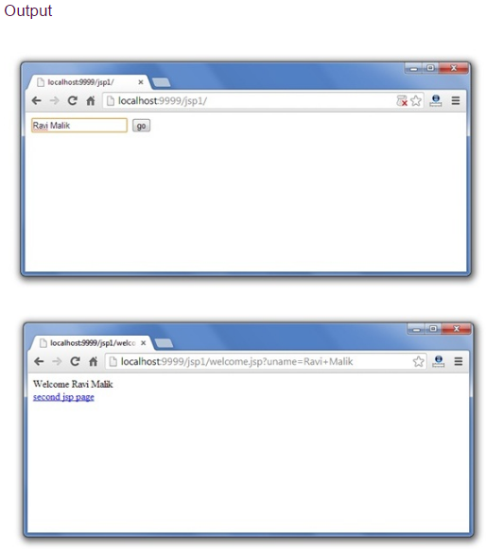

Slide 14
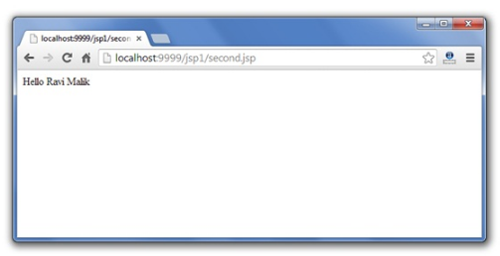

Slide 15
exception implicit object
In JSP, exception is an implicit object of type java.lang. Throwable class. This object can be used to print the exception. But it can only be used in error pages.
It is better to learn it after page directive. Let's see a simple example:
Example of exception implicit object:
error.jsp
<%@ page isErrorPage="true" %>
<html>
<body>
Sorry following exception occured:<%= exception %>
</body>
</html>

Slide 16
Example of exception handling in jsp by the elements of page directive
In this case, you must define and create a page to handle the exceptions, as in the error.jsp page.
The pages where may occur exception, define the errorPage attribute of page directive, as in the process.jsp page.
There are 3 files:
index9.jsp for input values
process9.jsp for dividing the two numbers and displaying the result
error9.jsp for handling the exception

Slide 17
JSP directives
The jsp directives are messages that tells the web container how to translate a JSP page into the corresponding servlet.
Types of directives are as follows:
page directive
include directive
taglib directive
Syntax of JSP Directive
<%@ directive attribute="value" %>

Slide 18
JSP page directive
The page directive defines attributes that apply to an entire JSP page.
Syntax of JSP page directive
<%@ page attribute="value" %>
Attributes of JSP page directive
import
contentType
buffer
language
isELIgnored
pageEncoding
errorPage
isErrorPage

Slide 19
Jsp Include Directive
The include directive is used to include the contents of any resource it may be jsp file, html file or text file.
The include directive includes the original content of the included resource at page translation time (the jsp page is translated only once so it will be better to include static resource).
Advantage of Include directive
Code Reusability
Syntax of include directive
<%@ include file="resourceName" %>

Slide 20
Taglib Directive
This directive basically allows user to use Custom tags in JSP. we shall discuss about Custom tags in detail in coming JSP tutorials. Taglib directive helps you to declare custom tags in JSP page.
Syntax of Taglib Directive:
<%@taglib uri ="taglibURI" prefix="tag prefix"%>Where URI is uniform resource locator, which is used to identify the location of custom tag and tag prefix is a string which can identify the custom tag in the location identified by uri.
Example of Targlib:
<%@ taglib uri="http://www.sample.com/mycustomlib" prefix="demotag" %> <html> <body> <demotag:welcome/> </body> </html>As you can see that uri is having the location of custom tag library and prefix is identifying the prefix of custom tag. Note: In above example – <demotag: welcome> has a prefix demotag.

Slide 21
Summary:
In this session, you were able to :
• JSP declaration, JSP directives, JSP Scriptlets

Slide 22
References:
Books:
1. Balaguruswamy, Java.
2. A Primer, E.Balaguruswamy, Programming with Java, Tata McGraw Hill Companies
3. John P. Flynt Thomson, Java Programming.
Video Lectures :
https://www.youtube.com/watch?v=NQ7xKNULkTk
Reference Links:
https://beginnersbook.com/2013/05/jsp-tutorial-directives/
https://docs.oracle.com/javaee/5/tutorial/doc/bnaou.html
https://beginnersbook.com/2013/05/jsp-tutorial-scriptlets/
https://www.javatpoint.com/jsp-scriptlet-tag
https://beginnersbook.com/2013/05/jsp-tutorial-directives/
https://beginnersbook.com/2013/11/jsp-declaration-tag/

